Slide 1

TIME SERIES FORECASTING WITH ADVANCED RECURRENT NEURAL NETWORKS FOR TRAFFIC
By Abdulmuhsin Alanazi , Thabet Aljebreen , Niaf Alsabhan , Mohammed Aldeaj

Slide 2



IMPORTING LIBRARIES
Data Manipulation
Data Visualization
Model Building
Pandas and NumPy for efficient data processing and analysis
Matplotlib for creating insightful visualizations of the traffic data
Keras for constructing and training the LSTM and GRU neural network models
These essential libraries provide the necessary tools for data processing, exploration, and the development of advanced time series forecasting models.

Slide 3
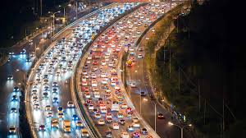
Data
Data Manipulation
Data Visualization
Model Building
Pandas and NumPy for efficient data processing and analysis
Matplotlib for creating insightful visualizations of the traffic data
Keras for constructing and training the LSTM and GRU neural network models
Target : vehicle count, Time : 15 min , filter : Tuesday

Slide 4





DATA LOADING AND EXPLORATION
Step 1
Step 3
Step 5
Load traffic data from a CSV file containing vehicle counts and timestamps
Convert the DateTime column to a datetime format for time series analysis
Visualize the traffic patterns over time to identify seasonal trends and other patterns
Step 2
Step 4
Filter the data to focus on a specific day (e.g., Tuesday) for analysis
Perform exploratory data analysis to understand the data distribution, trends, and any anomalies

Slide 5
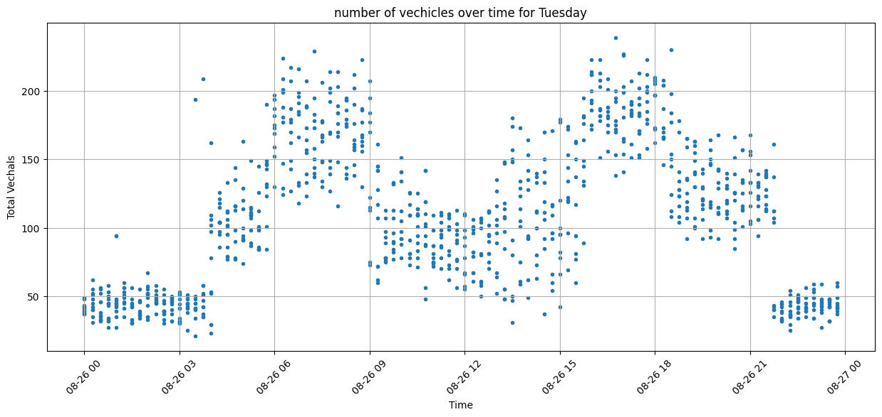
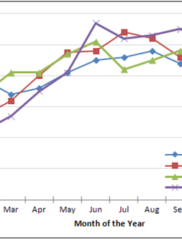
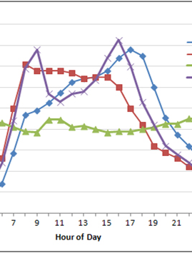
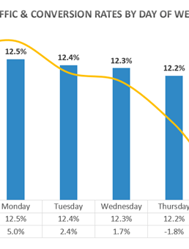
DATA VISUALIZATION
Time Series scatter Plot
Hourly Traffic Patterns
Visualizing the number of vehicles every Tuesday over time to identify trends and patterns.
Examining the hourly distribution of vehicle counts to understand peak and off-peak traffic over 15 minits periods.

Slide 6


DATA PREPROCESSING
Data Normalization
Sequence Preparation
The vehicle count data is normalized using MinMaxScaler to ensure all input features are within a consistent range, improving model convergence during training.
The preprocessed data is prepared for the RNN models by creating sequences of data, which allows the LSTM and GRU models to learn from the temporal dependencies in the traffic data.

Slide 7
MODEL BUILDING WITH LSTM AND GRU
LSTM (Long Short-Term Memory)
A type of RNN that uses memory cells and gates to effectively capture long-term dependencies in sequential data, making it well-suited for time series forecasting.
GRU (Gated Recurrent Unit)
A simplified version of LSTM, with a reduced computational complexity while still maintaining the ability to model dependencies in sequential data.
RNN Model Building
The project builds multiple Recurrent Neural Network (RNN) models, leveraging both LSTM and GRU layers to capture both short-term and long-term patterns in the traffic data.

Slide 8



TRAINING THE MODELS
Epochs:20
Early Stopping
Batch Size:64
Model Checkpointing

Slide 9
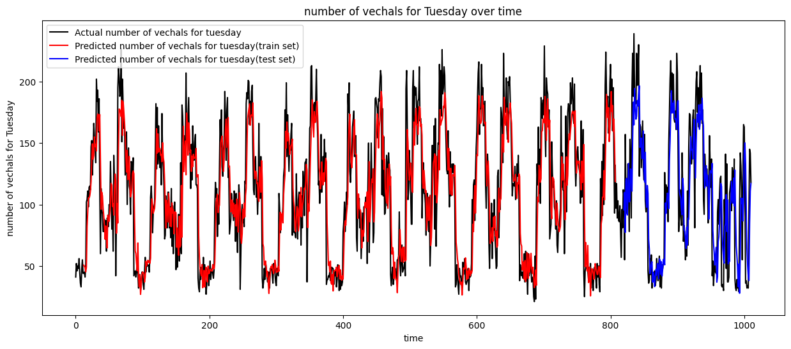
PREDICTION AND EVALUATION

Slide 10
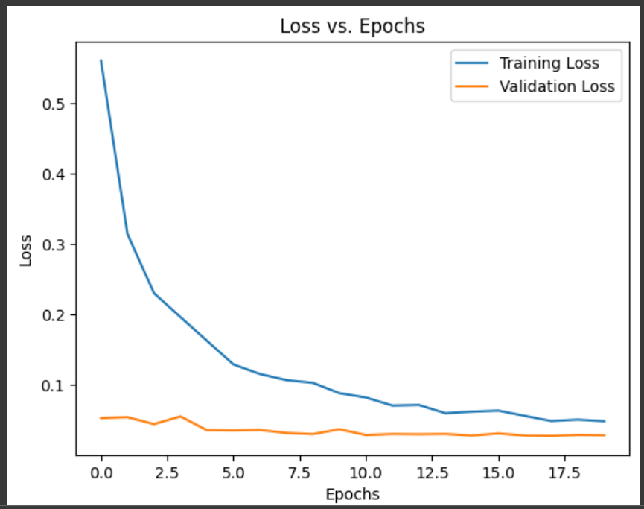
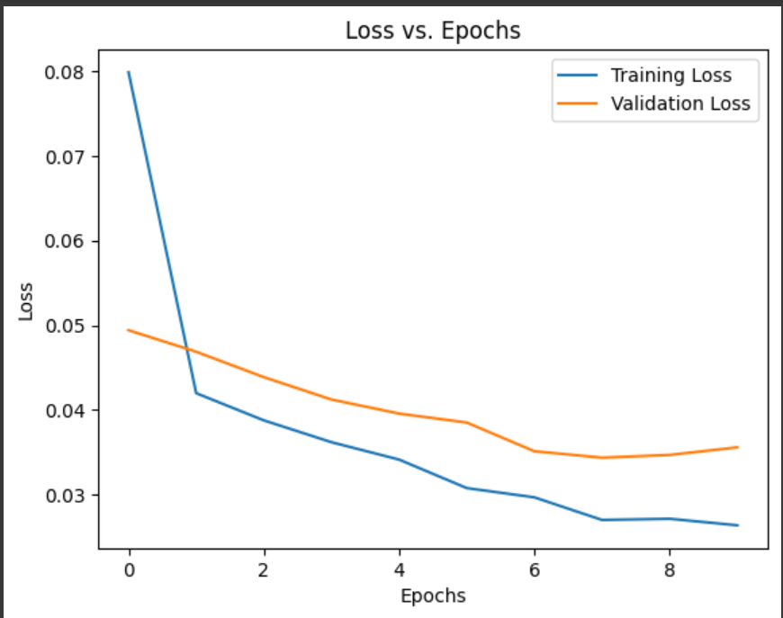
PREDICTION AND EVALUATION

Slide 11
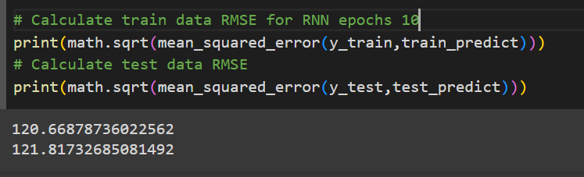
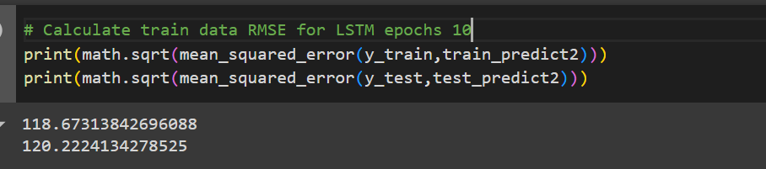
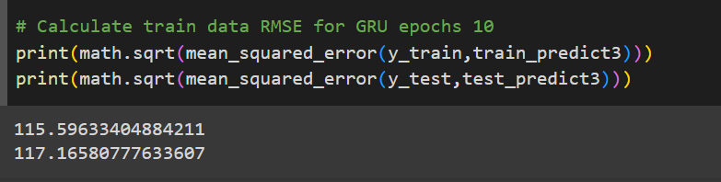
PREDICTION AND EVALUATION

